Slide 1
Strings

Slide 2
What is a string?
In many other programming languages, string is a sequence of characters.
In Java, strings are objects.
Strings are surrounded by double quotes.
Strings are immutable. Once a string is created, it can’t be changed.
If we want to to modify a string, it will create a new string which contains the modifications.

Slide 3
String Input and Output
.next() and .nextLine() of the scanner class is used to take string as input.
.next() only takes input until it finds a “ ” or space in the given input.
.nextLine() takes input until it finds a “\n” in the given input.
class stringInput{
public static void main(String[] args) {
Scanner sc = new Scanner(System.in);
String input1 = sc.next();
String input2 = sc.nextLine();
System.out.println(input1);
System.out.println(input2);
}
}
Welcome to DrJava. Working directory is C:\Users\Desktop
>
>
CSE
CSE IS FUN.
CSE IS FUN.
CSE IS FUN.

Slide 4
String Initialization
Initialization using String literals:
Literal
String
String my_string = “Hello World!”;
Variable name

Slide 5
String Initialization
Creating an object of String class:
To create an object of String class
Class name
String my_str = new String( “Hello”);
Object name
String

Slide 6
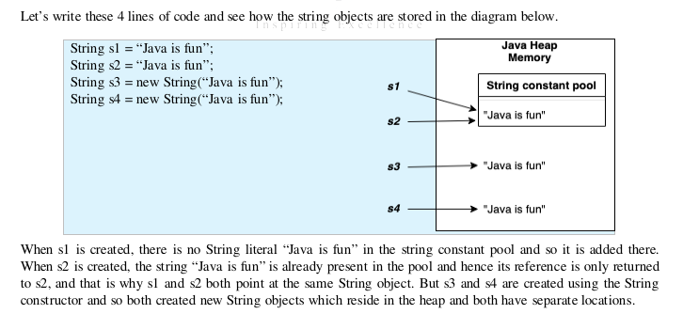
String Initialization

Slide 7
String Length
The number of characters in a string.
Can find using the length() method.
class stringLength {
public static void main(String[] args) {
String str1 = "Hello World";
String str2 = ""; // Empty string
System.out.println(str1.length());
System.out.println(str2.length());
}
}
Welcome to DrJava. Working directory is C:\Users\Desktop
> run stringLength
11
0

Slide 8
String Indexing
String indexing starts from 0 and ends at (Length of string - 1).
If we create string1 = “CSE IS FUN.”, which has a length of 11, the indexing will look like this:
Blanks and special characters are also counted as characters.
We can get characters at each each index by using charAt(index) method. Example: string1.charAt(2) will return “E”.
0 | 1 | 2 | 3 | 4 | 5 | 6 | 7 | 8 | 9 | 10
C | S | E |  | I | S |  | F | U | N | .

Slide 9
Iterating a String
Accessing the characters of a string one by one.
Iterating a string using for loop and charAt() method.
class StringIteration {
public static void main(String[] args) {
String str = new String("Hello");
for (int i = 0; i <str.length(); i++){
System.out.println(str.charAt(i));
}
}
}
Welcome to DrJava. Working directory is C:\Users\Desktop
> run StringIteration
H
e
l
l
o

Slide 10
String Concatenation
“+” is used to concatenate two or more strings together.
New string created after concatenation.
If a different data type follows a string data type in concatenation, that data is automatically converted to string.
String str1 = "We are learning";
String str2 = "Java.";
int num = 123;
String str3 = str1 + str2;
String str4 = str1 + num;
System.out.println(str3);
System.out.println(str4);
Welcome to DrJava. Working directory is C:\Users\Desktop
We are learning Java.
We are learning 123

Slide 11
String Concatenation
Output:
Fall2023
Output:
43Fall
String semester = “Fall ” ; int y1 = 20; String output = semester + y1 + 23; System.out.println(output);
String semester = “Fall ” ; int y1 = 20; String output = y1 + 23 + semester; System.out.println(output);

Slide 12
Comparing Strings
String str1 = new String(“Hello”); String str2 = new String(“hello”);
Methods | Functions | Method Call | Value returned
.equals() | Checks if values in two strings are same. Case sensitive. | str1.equals(str2) | False
.equalsIgnoreCase() | Checks if values in two strings are same. Not case sensitive. | str1.equalsIgnoreCase(str2) | True
== or equals operator | Checks if reference (address) of two strings are same. | str1 == str2 | False
.compareTo() | Compares two string values lexicographically. Returns 0 when identical, (+)ve when first string is greater and (-)ve values when second string is greater respectively. | str1.compareTo(str2) | -32 (The output is -32 since “H” is 32 less than “h” lexicographically)

Slide 13
Case Conversion
.toLowerCase()
  Converts all characters to lowercase letters.
.toUpperCase()
  Converts all characters to uppercase letters.
String str1 = "LearNinG IS Fun";
String str1_lower= str1.toLowerCase()
String str1_upper = str1.toUpperCase()
System.out.println(str1_lower)
System.out.println(str1_upper)
Welcome to DrJava. Working directory is C:\Users\Desktop
>learning is fun
LEARNING IS FUN

Slide 14
.charAt(index) Method
.charAt(index)
  Returns the character at index value passed as argument.
String str1 = "Hello World";
System.out.println(str1.charAt(3))
Welcome to DrJava. Working directory is C:\Users\Desktop
>o

Slide 15
ASCII values
Unique Unicode value assigned to all keyboard characters.
Range of ASCII values of uppercase characters (‘A’ to ‘Z’): 65 - 90
Range of ASCII values of uppercase characters (‘A’ to ‘Z’): 97 - 122
ASCII value of space: 32
See more from:
https://www.cs.cmu.edu/~pattis/15-1XX/common/handouts/ascii.html

Slide 16
Converting a Character to ASCII Value
.codePointAt(index)
  Takes an index of a string as a parameter and returns the ASCII value of the character of that index.
int(chr)
  Can simply cast a character as an integer.
String str1 = "CSE110";
int unicode_str1 = str1.codePointAt(0);
System.out.println(unicode_str1)
Welcome to DrJava. Working directory is C:\Users\Desktop
>67
char c1 = 'a';
int unicode_c1 = int(c1);
System.out.println(unicode_c1)
Welcome to DrJava. Working directory is C:\Users\Desktop
>97
Can you now try to figure out how you can convert an uppercase character to its equivalent lowercase character using the knowledge you gained on ASCII values so far?

Slide 17
Practice
Write a Java program to compare two strings lexicographically. You cannot use any built in function except length().
Write a Java program to test if a given string contains the specified sequence of char values.
Write a Java program to check whether a given string ends with another string.
Write a Java program to replace a specified character with another character.
Write a Java program to get a substring of a given string at two specified positions.
Write a Java program to convert all characters in a string to lowercase.
Write a Java program to print the result of removing duplicates from a given string.

Slide 18
THANK YOU!

